Slide 1

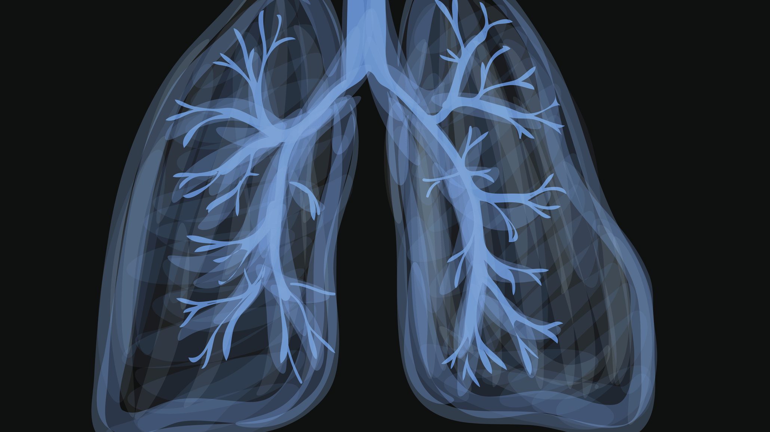
Comparing Annual Growth in Pulmonary Function in Children treated with Inhaled Anti-inflammatory Drugs
Holin Chen, Kushagra Vashist, Emily Drzymalla, Bradley Frueh

Slide 2
Background
Asthma is a chronic disease characterized by inflammation of the bronchi resulting in reversible obstruction of the airway
Over 7 million children are affected by asthma in the US.
To promote airflow and relieve acute (potentially life threatening) symptoms, patients are treated with a combination of beta agonists, steriods, and anti-inflammatory drugs.
The Childhood Asthma Management Program Research Group. Long-term effects of budesonide or nedocromil in children with asthma. N Engl J Med 2000;343:1054-1063

Slide 3

The CAMP Trial
The Childhood Asthma Management Program (1995)
A multicenter, masked, placebo-controlled trial of children with mild to moderate asthma
1,041 children between the ages of 5 and 12
Subjects were randomly assigned to 3 treatment groups
- 311 assigned Budesonide (corticosteriod)
- 312 assigned Nedocromill (NSAID)
- 418 assigned Albuterol as placebo

Slide 4
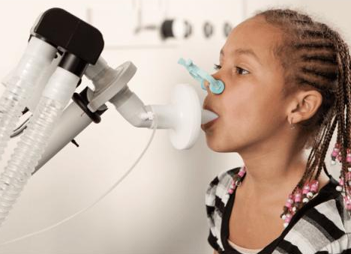
Data Collection
Subjects received assigned treatment twice daily for four to six years
Approximately once every two months pulmonary function was tested twice. Once before and once after bronchodilation with assigned therapy.
Unstructured and unequal measurements
After six years of followup, daily treatment stopped but follow up continued for four more years

Slide 5
STUDY AIMS
Using a teaching subset of the original CAMP data, we aim to investigate long term differences in annual rate of growth in pulmonary function as measured by Forced Expiratory Volume Per Second (FEV1).
Primary Research Question:
Are there differences in annual rate of growth in pulmonary function between children receiving continuous, long term treatment with corticosteroids (Budesonide), NSAIDs (Nedocromill), and placebo (Albuterol).
Secondary Research:
Is the association in annual rate of growth in pulmonary function and treatment group confounded by age or gender? (Did the randomization work?)

Slide 6
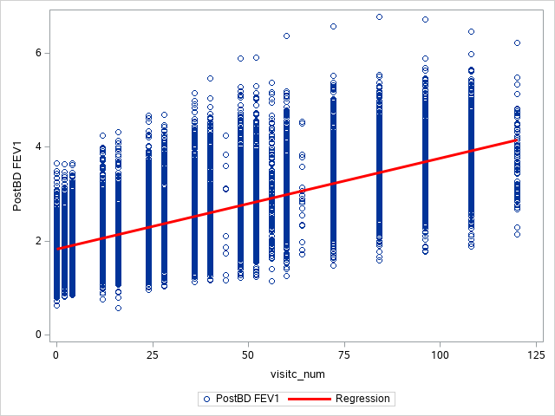
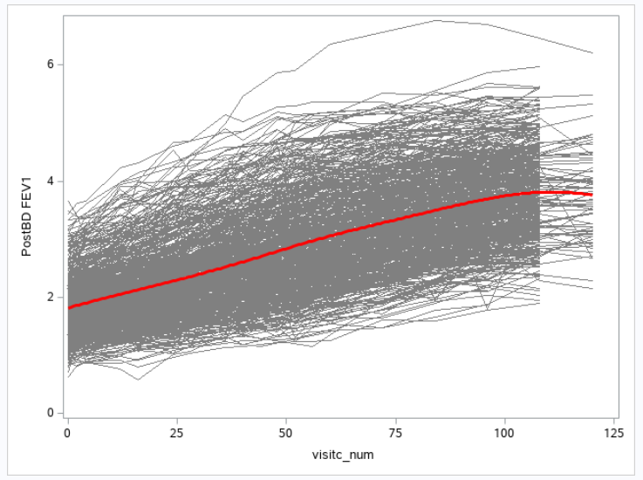
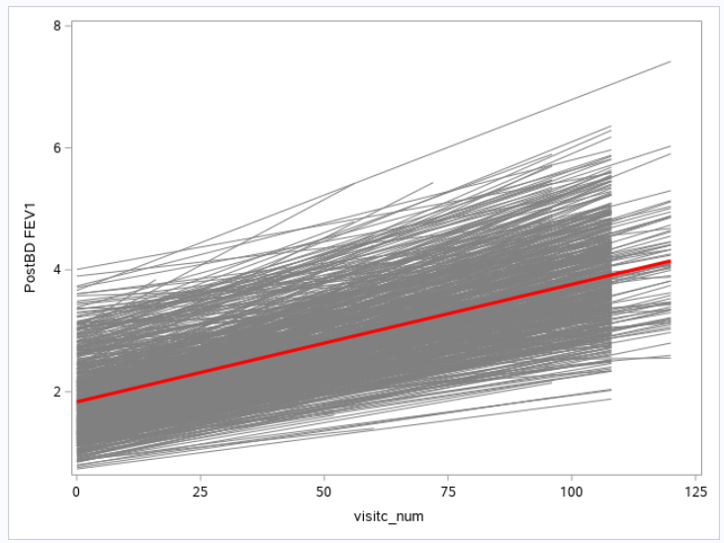
Graphical Analysis
*Time represented by number of monthly visits since randomization
Graphical analysis suggested that FEV1 increased linearly over time
A large drop in subjects around month 106 (8.3 years)
Variation is larger towards the end of study followup

Slide 7
Variables of Interest
Outcome: FEV1 post treatment
Level 1 Predictor: Monthly visits since randomization
Level 2 Predictor: Treatment group
A: Budesonide
B: Nedocromill
C: Albuterol
Potential Confounders: Age at randomization and gender

Slide 8
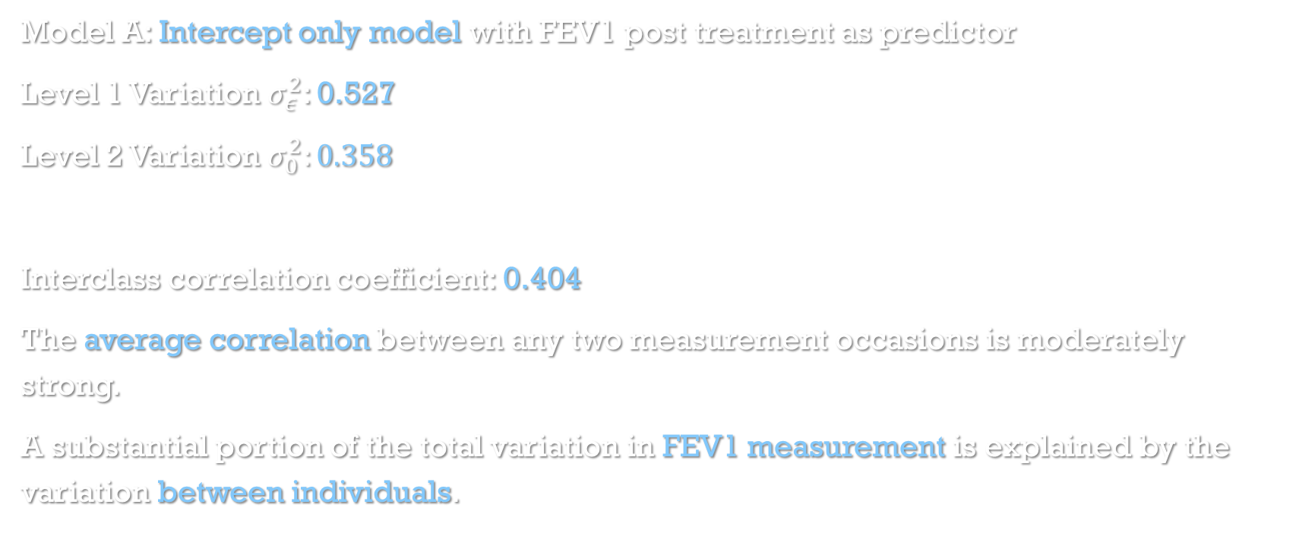
Model Comparisons: Unconditional Means
Model A: Intercept only model with FEV1 post treatment as predictor
Level 1 Variation $σ_{ε}^{2}$: 0.527
Level 2 Variation $σ_{0}^{2}:0.358$
Interclass correlation coefficient: 0.404
The average correlation between any two measurement occasions is moderately strong.
A substantial portion of the total variation in FEV1 measurement is explained by the variation between individuals.

Slide 9
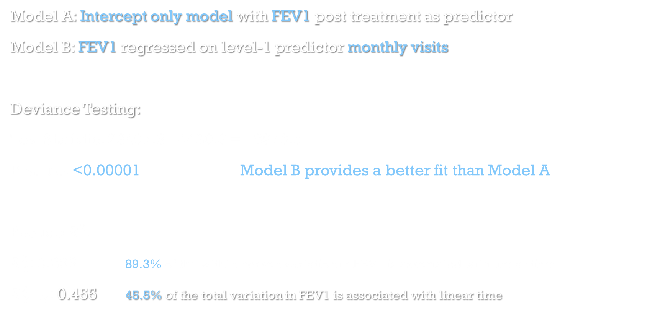
Model Comparisons: Unconditional Means VS Unconditional Growth
Model A: Intercept only model with FEV1 post treatment as predictor
Model B: FEV1 regressed on level-1 predictor monthly visits
Deviance Testing:
Test Statistic: 23407.3 - 4430.8 = 18976.5
P-value: <0.00001 Model B provides a better fit than Model A
Pseudo $R^{2}$:
$R_{ ε}^{2}$: 0.893 89.3% of the within person variation in FEV1 is associated with linear time
$R_{ Y −Y}^{2}$: 0.455 45.5% of the total variation in FEV1 is associated with linear time

Slide 10
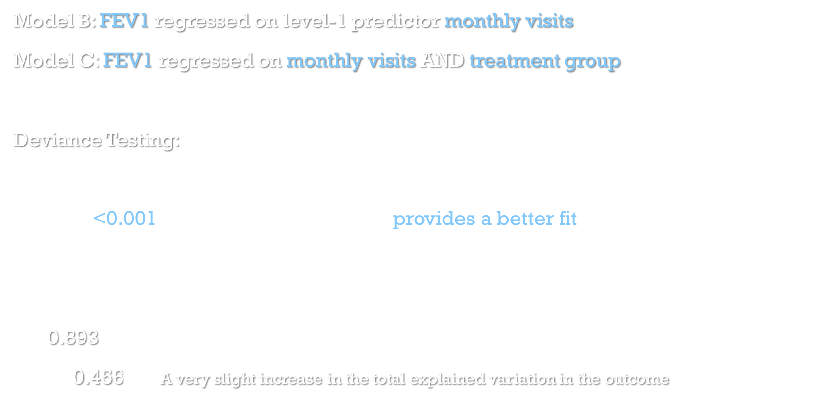
Model Comparisons: Model B VS Model C
Model B: FEV1 regressed on level-1 predictor monthly visits
Model C: FEV1 regressed on monthly visits AND treatment group
Deviance Testing:
Test Statistic: 4430.8 - 4419 = 11.8
P-value: <0.001 Model C provides a better fit than Model B
Pseudo $R^{2}$:
$R_{ ε}^{2}$: 0.893 Model C explains the same amount of within person variation as Model B
$R_{ Y −Y}^{2}$: 0.456 A very slight increase in the total explained variation in the outcome

Slide 11
Model Comparisons: Model C VS Model D
Model C: FEV1 regressed on monthly visits AND treatment group
Model D: FEV1 regressed on monthly visits AND treatment group AND age at randomization
Deviance Testing:
Test Statistic: 4419.7 - 4415.2 = 4.5
P-value: 0.03 Model D DOES NOT provide a better fit than Model C
Conclusion: Randomization worked

Slide 12
Model Comparisons: Model C VS Model E
Model C: FEV1 regressed on monthly visits AND treatment group
Model E: FEV1 regressed on monthly visits AND treatment group AND gender
Deviance Testing:
Test Statistic: 4419.7 - 4418.5 = 1.2
P-value: 0.27 Model E DOES NOT provide a better fit than Model C
Conclusion: Randomization worked

Slide 13
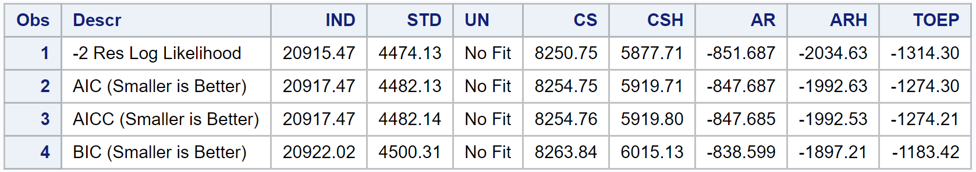
Error Covariance StructureS
Using Model C, we compared common error convariance structures used in longitudinal analysis
The structure that best fit the data based on goodness-of-fit statistics was Heterogeneous Autogressive (ARH)
To provide additional evidence that ARH was the optimal error structure, we ran a correlation matrix on measurement occassions. Correlations between time points grew weaker the further apart they were, providing evidence of band symmetry.

Slide 14
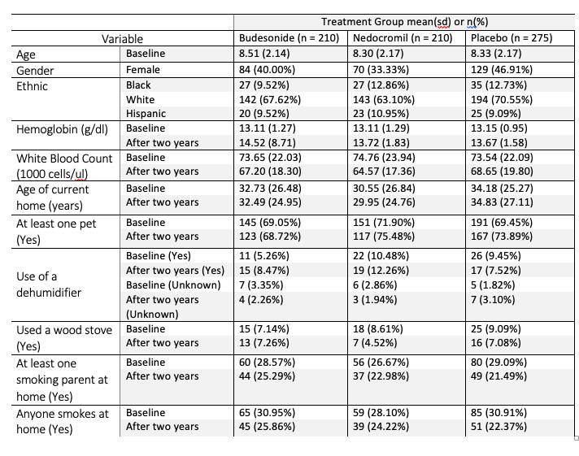
Results
Table 1: Participant Characteristics
RESULTS
Because of the study design of randomized clinical trial, most characteristic variables(e.g. age at baseline, gender, ethnic) in this table were distributed similarly across the three treatment groups

Slide 15
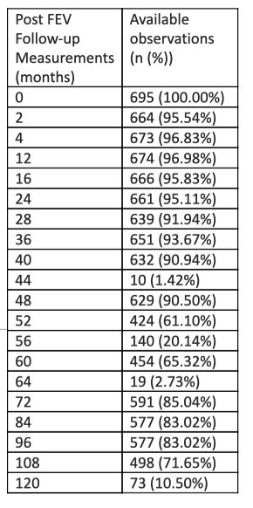
Available FEV1 measurements

Slide 16
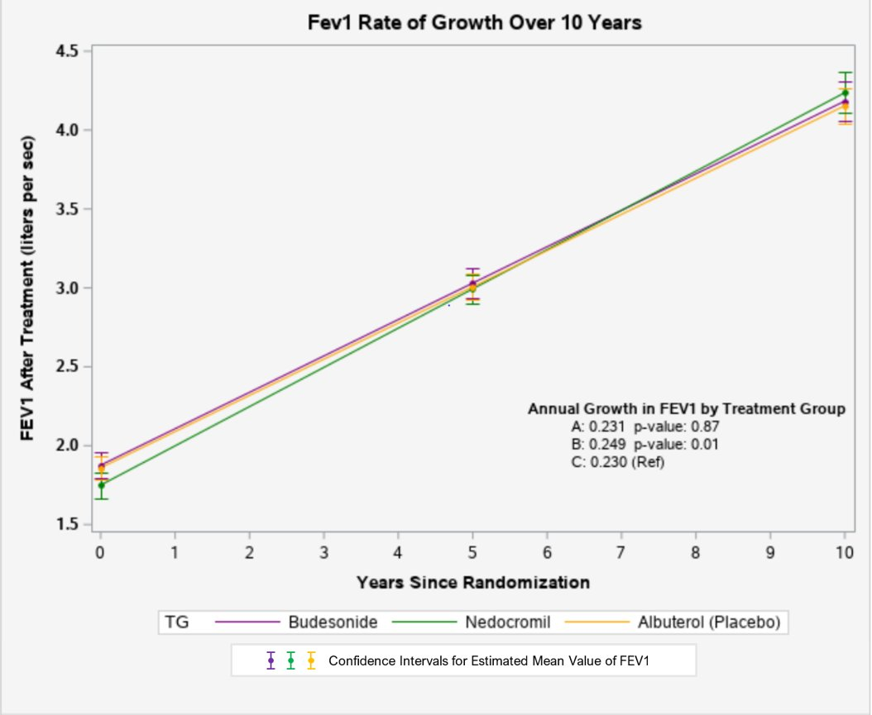
Final Model Results
Interaction between treatment A (budesonide) and time is not statistically significant
Interaction between treatment B (nedocromil) and time is statistically significant.
There is no significant difference in the initial status of post FEV1 among treatment A, B and C.

Slide 17
Questions?

